Slide 1

CapstoneConnect
Ayushmann Kukreja
Murtaza Mehdi
Abdul Rehman Khan
Ms. Urooj Waheed
Ms. Yusra Mansoor
DHA Suffa University

Slide 2
Summary
Introduction / Idea
Jury Members and stakeholders Feedback
Work Done with respect to Proposed Plan
Demo of work done

Slide 3
Introduction / Idea
Empowering capstone projects: Introducing a centralized portal for seamless project selection and communication. Enhance your project journey with transparency and enriched learning experiences.

Slide 4
Jury Members and stakeholders Feedback
Feedback Received:
"Need to work on scope. Scope is small as per understanding. Project presentation and document needs to be improved.“
Action:
Expanded Project Scope:
Implemented a new feature to enhance project evaluation.
Introduced similarity detection mechanism for submitted project abstracts.
Ensures uniqueness and promotes originality.
Improved Presentation and Documentation:
Enhanced quality and thoroughness of project presentation.
Detailed explanations of objectives, methodology, and outcomes.
Revised and expanded documentation for clearer insights.

Slide 5
Work Done with respect to Proposed Plan
Requirement Gathering Phase:
Conducted surveys among students and supervisors.
Result: Around 90% of students and 95% of supervisors expressed the need for a dedicated FYP portal.
Analysis and Design Phase:
Backend Development:
Created a comprehensive structure for ASP.NET Core application.
Remaining: Adding business logic layers.
User Interface Design:
Designed initial Figma layouts for student, supervisor, and administrator panels.
Database Design:
Decision: Adopting the DB-first approach in ASP.NET Core application.
Development and Implementation Phase:
Created the majority of screens for students, supervisors and administrator
Remaining: Finalizing few modifications for enhanced usability and functionality.

Slide 6
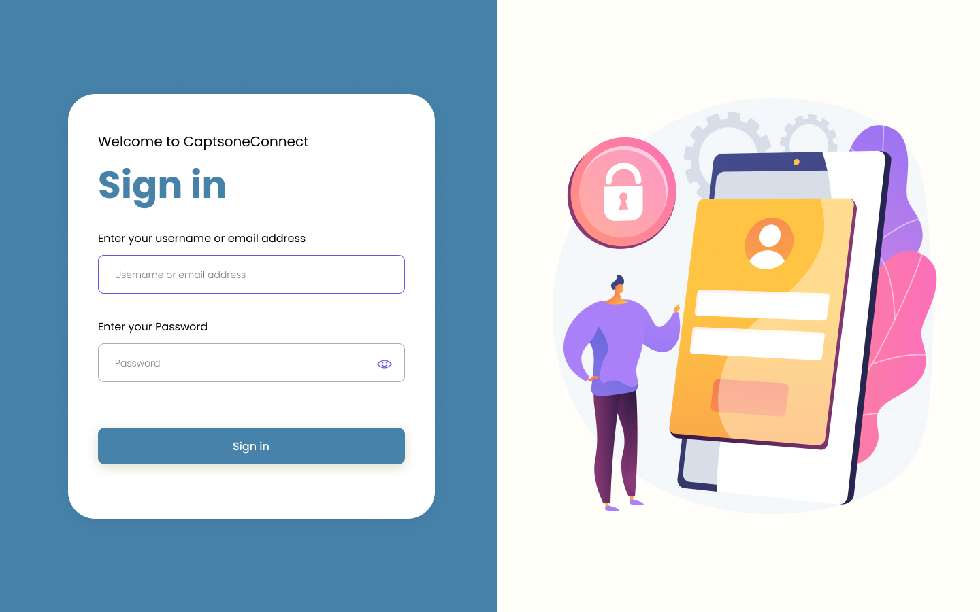
Demo of work done
Front-End
Login

Slide 7
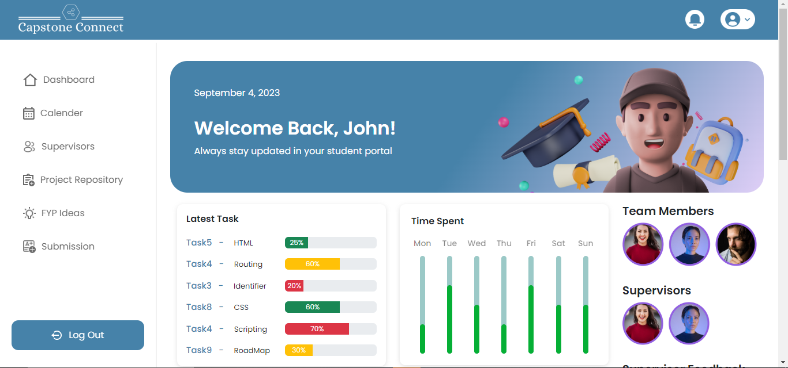
Demo of work done
Student Dashboard

Slide 8
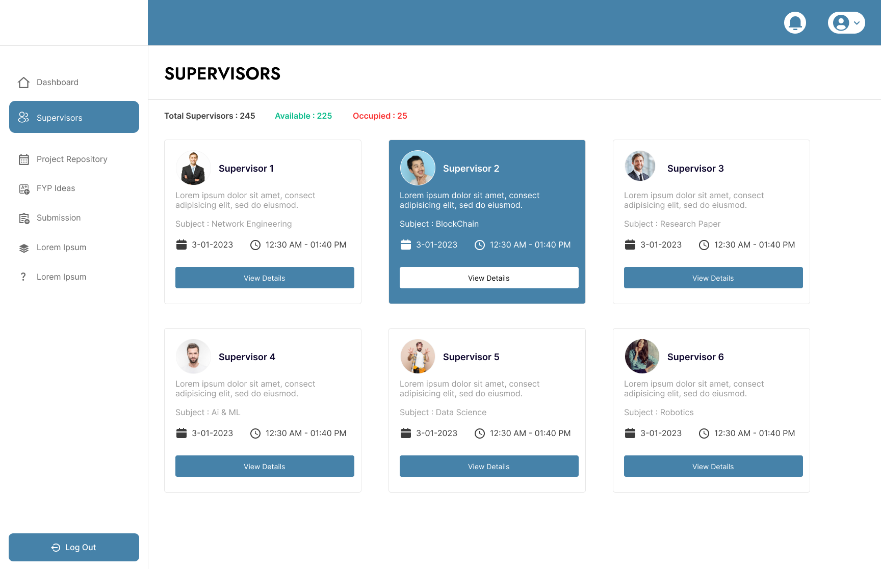
Demo of work done
Available Supervisors List

Slide 9
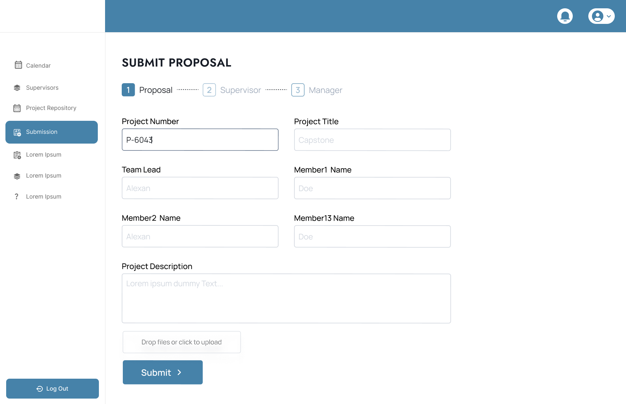
Demo of work done
Submission Portal

Slide 10
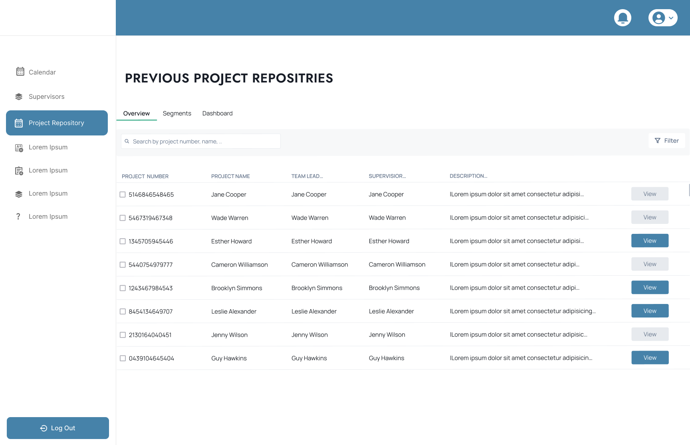
Demo of work done
Previous Project Repository

Slide 11
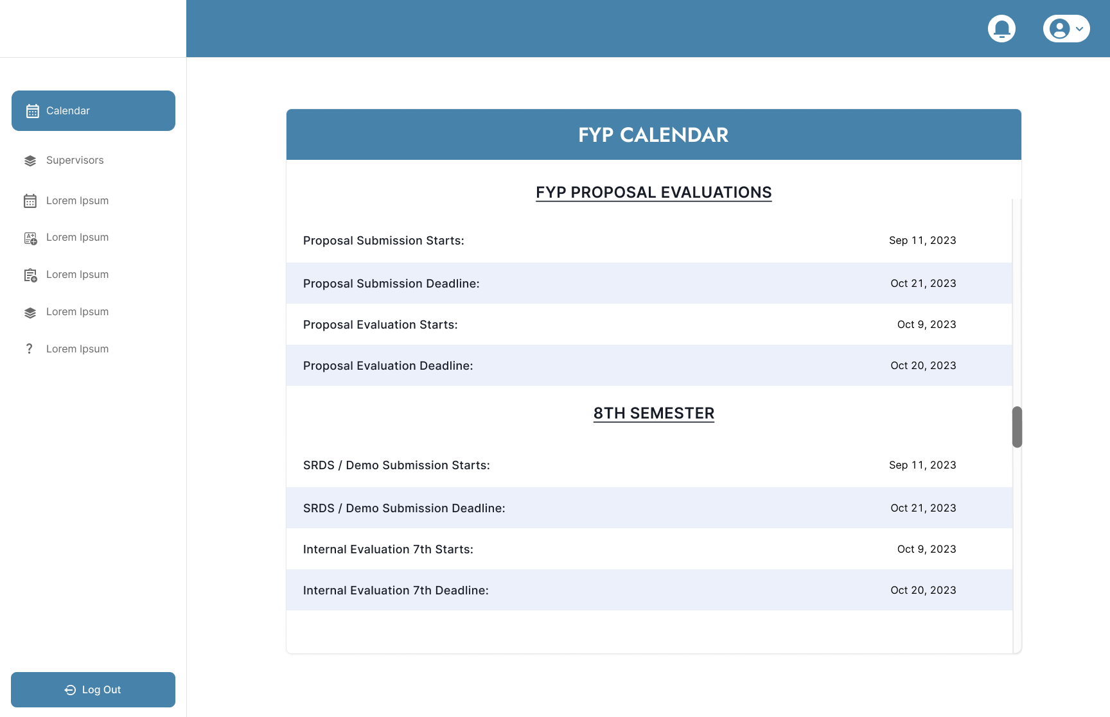
Demo of work done
FYP Calendar

Slide 12
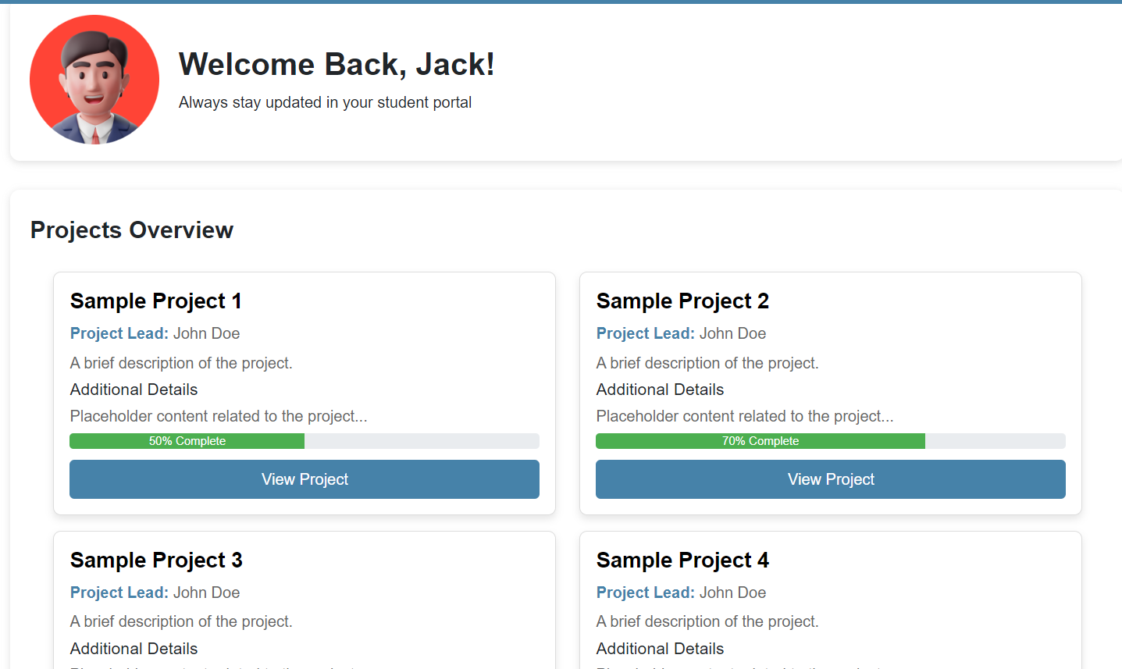
Demo of work done
Supervisor Dashboard

Slide 13
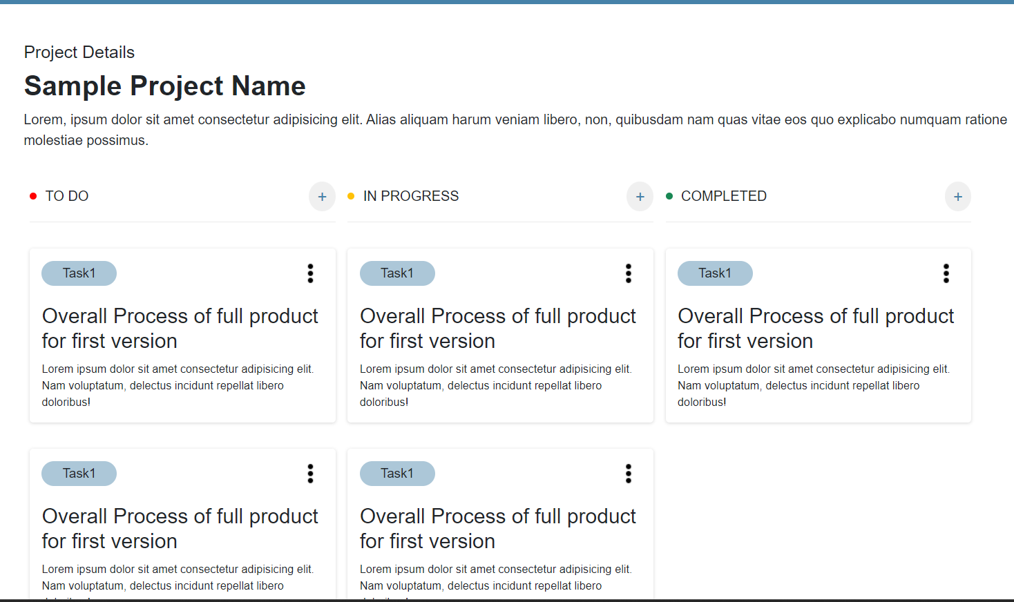
Demo of work done
Project View

Slide 14
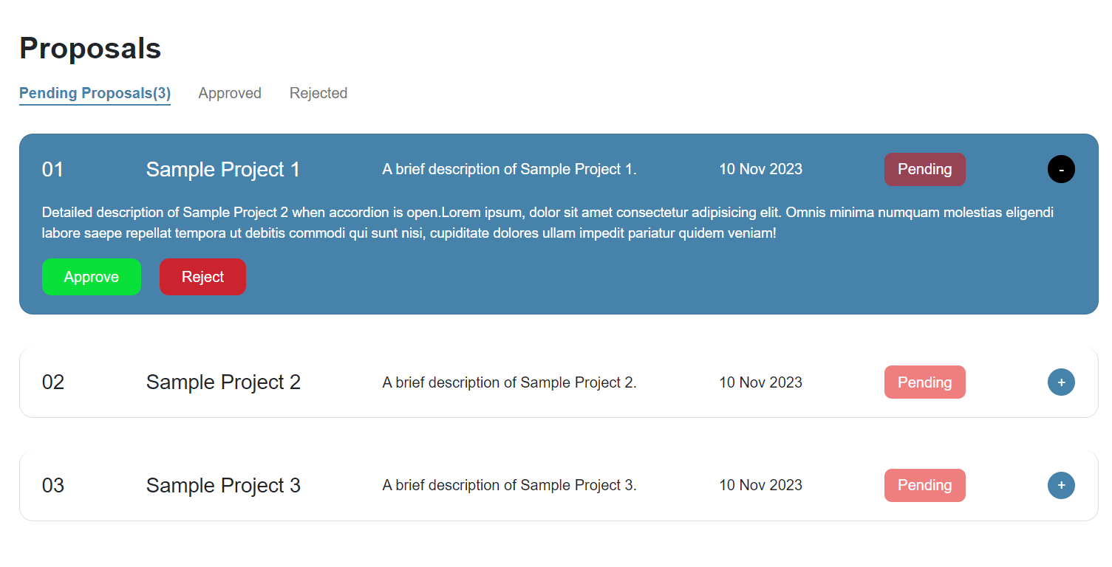
Demo of work done
Project Proposal View for Supervisor

Slide 15
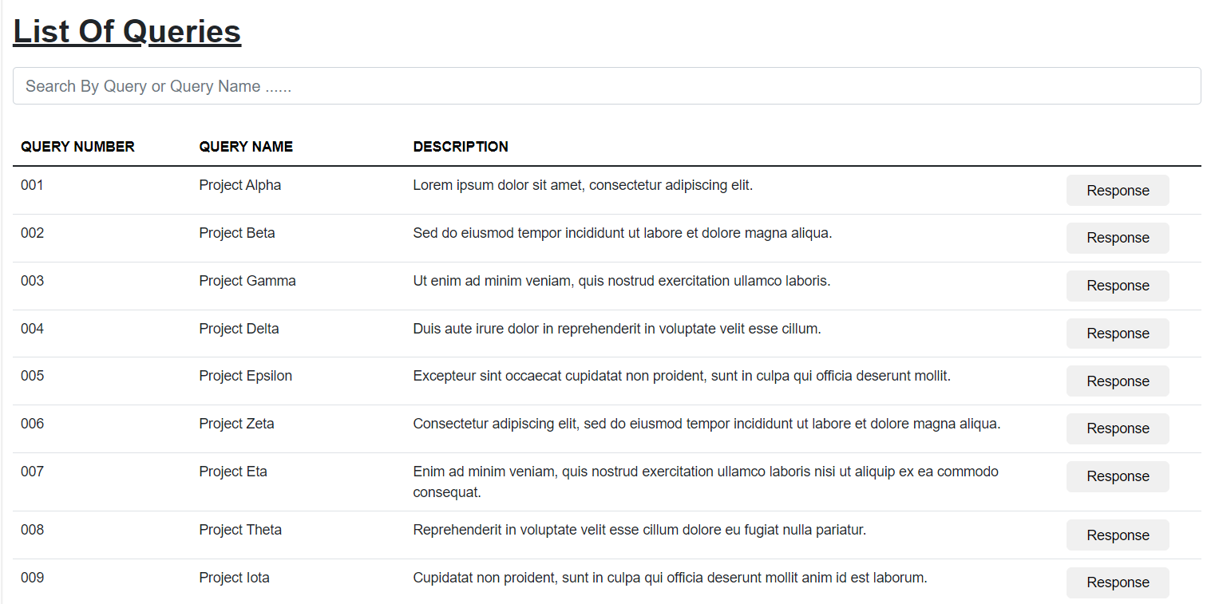
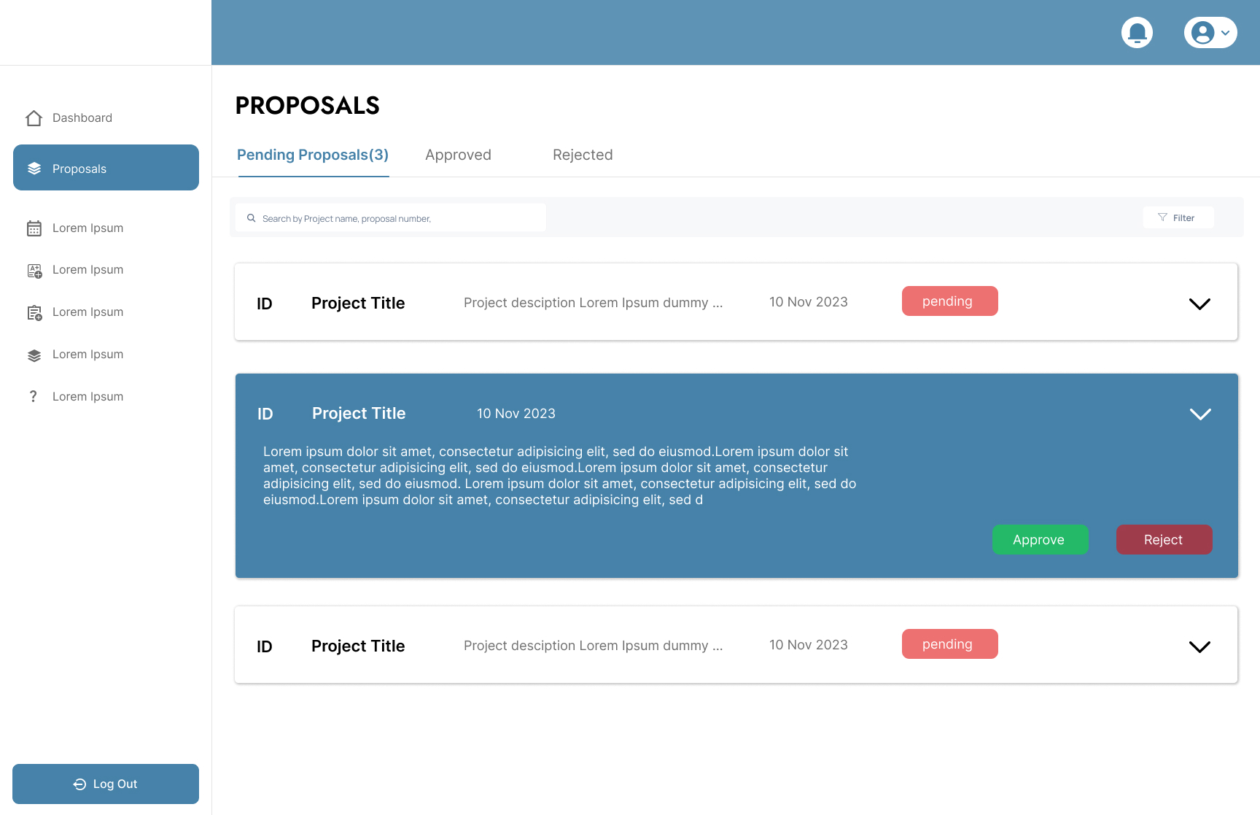
Demo of work done
List Of Queries:

Slide 16
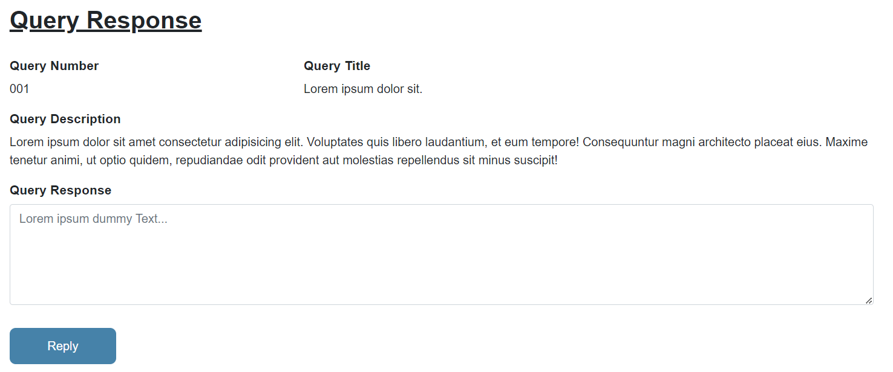
Demo of work done
Query Response

Slide 17
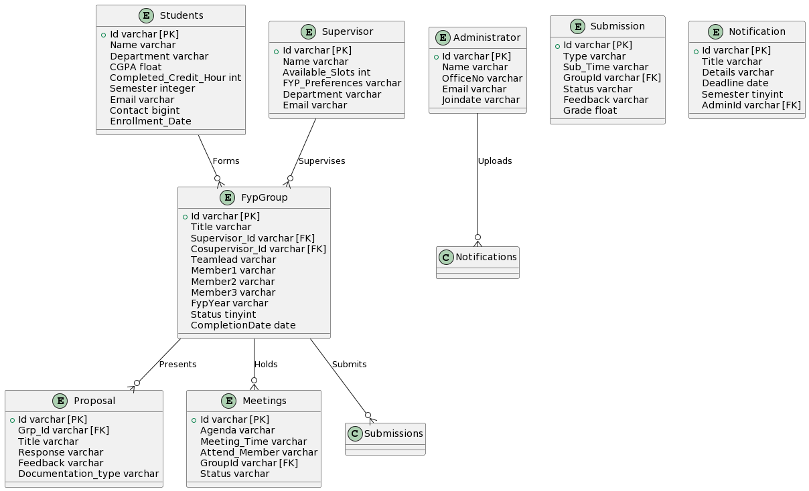
Demo of work done
Database

Slide 18
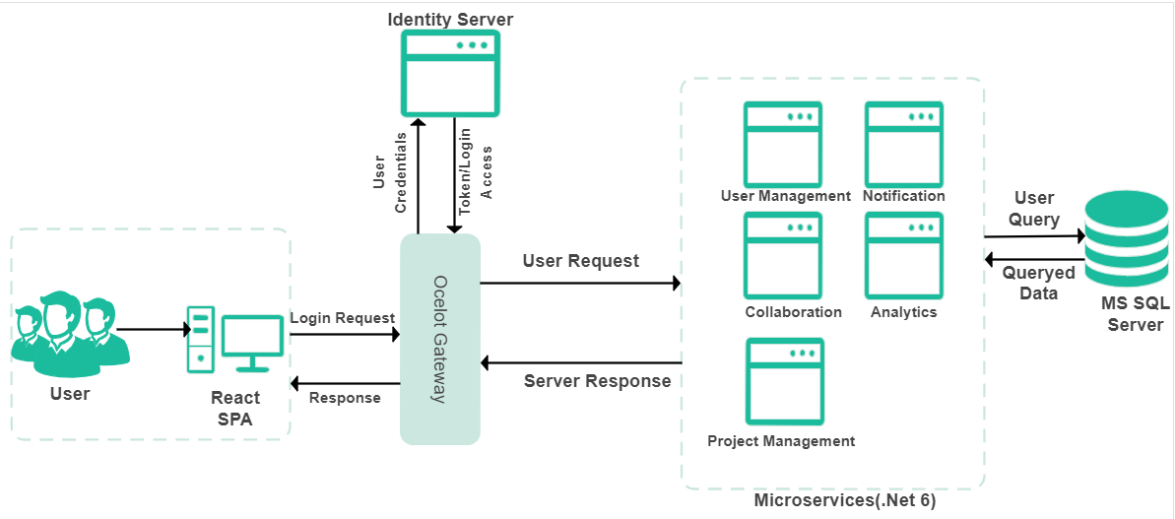
Demo of work done
Portal Architecture:

Slide 19
8- Reference
Survey references
Student: https://docs.google.com/forms/d/1apoqfz2By7jI_9HFvk14u2crz_xeoh6tHoWciTqNw7w
Supervisor: https://docs.google.com/forms/d/1KUwFyCuYuH_wcVgtBNF2bMwbE6ouuMt9sCjkxq_59ug

